Slide 1
Property Spotlight
Coweta Industrial Site 9

Slide 2
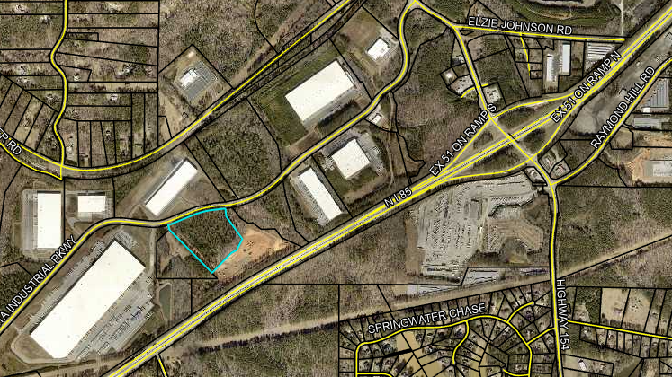
Coweta Industrial Site 9

