Slide 1
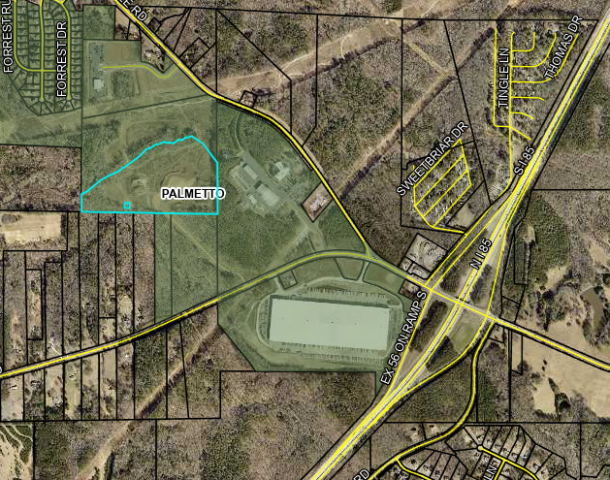
HQ Industrial- 800 Weldon Rd

Slide 2
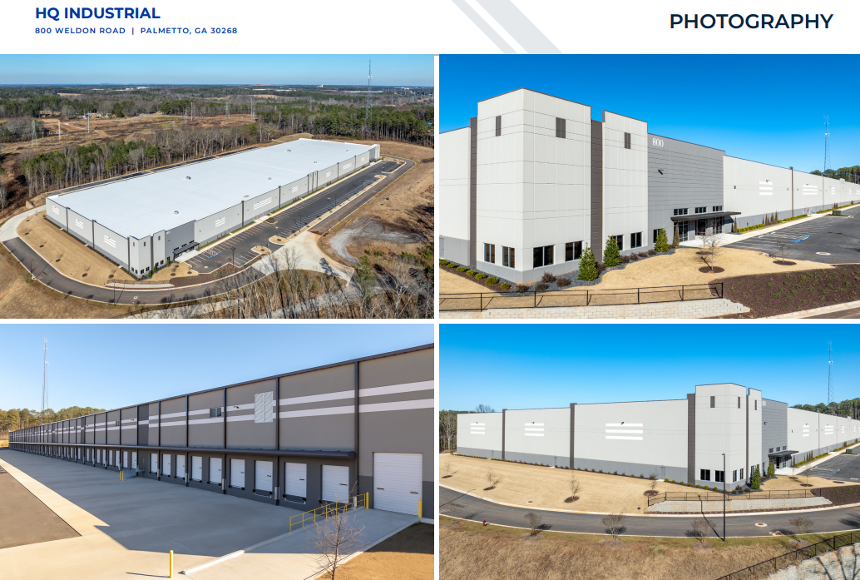

Slide 3
