Slide 1
Site Visits

Slide 2
2025 Site Visits
Date | Project | Type | Stage | CAPEX | Jobs
02.11.2025 | Sail | Data Center | Site Visit | $17B | 750
02.18.2025 | Indigo | Other | LOST | $1B | 25
02.27.2025 | 02.18.2025 | Manufacturing | WON | $5M | 20
03.06.2025 | Metroplex | Manufacturing | LOST | $750M | 1400
03.07.2025 | 02.19.2025/Fastnet | Manufacturing | LOST | $1B | 1000
03.11.2025 | 02.18.2025 | Manufacturing | WON | $5M | 20
03.20.2025 | Bullpen | Manufacturing | Site Visit | $35M | 236
03.24.2025 | Metroplex | Manufacturing | Site Visit | $750M | 1400
04.11.2025 | 02.19.2025/Fastnet | Manufacturing | LOST | $1B | 1000
04.18.2025 | 04.15.2025 | Distribution | Site Visit
05.14.2026 | Metroplex | Manufacturing | Site Visit | $750M | 1400
06.23.2025 | Corellia | Data Center | Site Visit | $1B | 50
07.21.2025 | DeLorean | Distribution | Site Visit
07.28.2025 | Gateway/Glass | Manufacturing | Site Visit | $700M | 450
07.29.2025 | 01.10.2025 | Manufacturing | Site Visit
08.06.2025 | F7/Dixie | Manufacturing | Site Visit | $65M | 150
08.03.2025 | Rose | Manufacturing | Site Visit
10.02.2025 | Onyx | Manufacturing | Site Visit | $2B | 370

Slide 3
One Win and 3 D’s

Slide 4
Losses

Slide 5
Reality

Slide 6
Trends & Insights in Economic Development
Economic Impact Study of Data Centers in Ohio

Slide 7
Economic Impact of Data Centers in Ohio
“Silicon Heartland”
$40 Billion+ in Private Investment
Columbus Top-Tier North American Data Center Market
OH Chamber of Commerce Research Foundation

Slide 8
Economic Contributions (2017-2024)
Employment: 38,400 to 95,200 (+148%)
GDP Contribution: $4.78B to $11.8B
Output: $10.4B to $26.4B
Labor Income: $3B to $6.99B

Slide 9
Fiscal Impact and Incentive Returns
State and Local Tax Revenue (2017-24): $5.21B
Incentives Provided: $2.5B
Net Fiscal Surplus: $2.71B (2.1:1 ROI on Incentives)

Slide 10
Property Spotlight
Coweta Industrial Park
Site 3

Slide 11
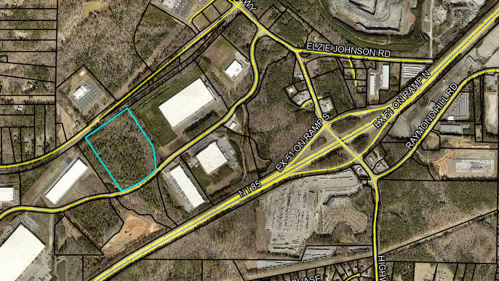
Coweta Industrial Park Site 3

Slide 12
Coweta Industrial Park Site 3
32.41 Acres
Light Industrial
Slope of 4%

