Slide 1
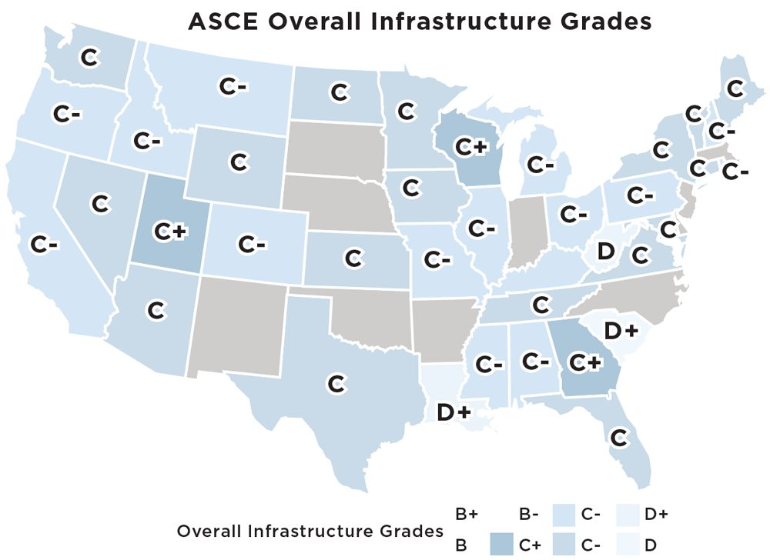

Slide 2
How U.S. Infrastructure Compares Globally
1. Singapore
2. Switzerland
3. Netherlands
4. Denmark
5. Germany
14. United States
Source: World Bank LPI 2023

Slide 3
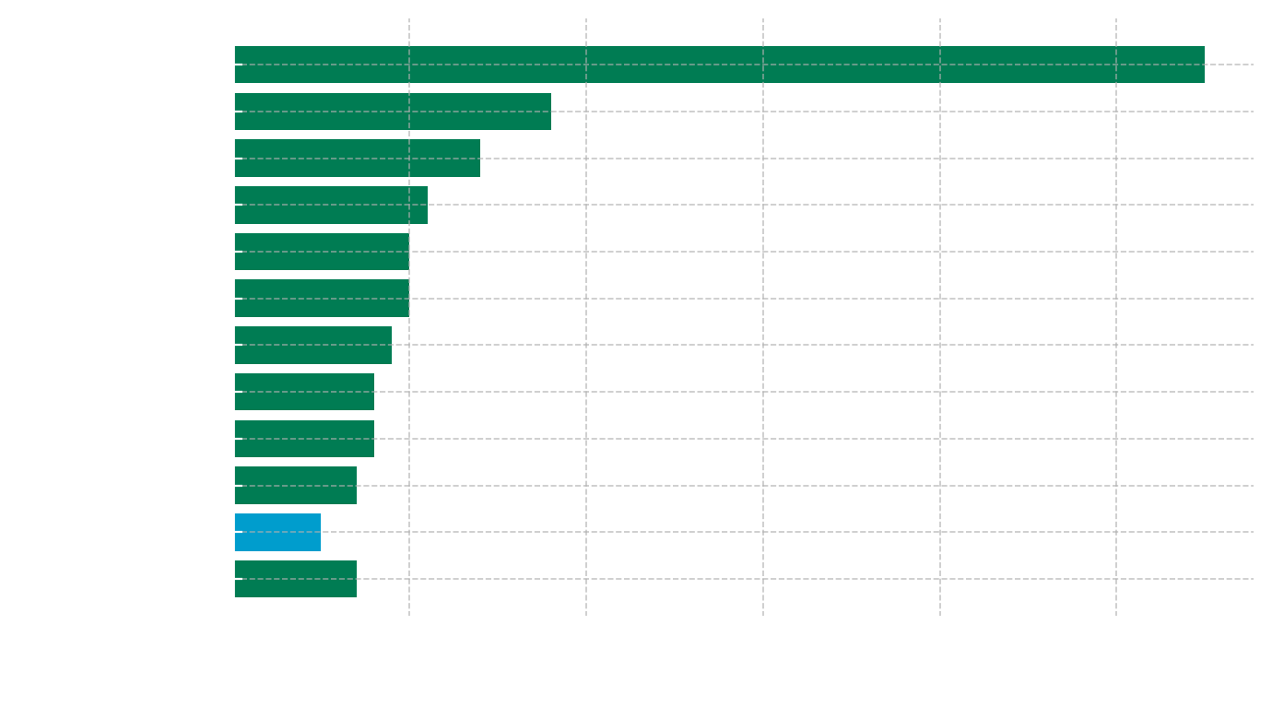
Infrastructure Investment Intensity
Source: OECD/ITF Transport Infrastructure Investment Database (2019-2023); Global Infrastructure Hund InfraCompass 2023

Slide 4
